Slide 1
Git
Branching and workflow

Slide 2
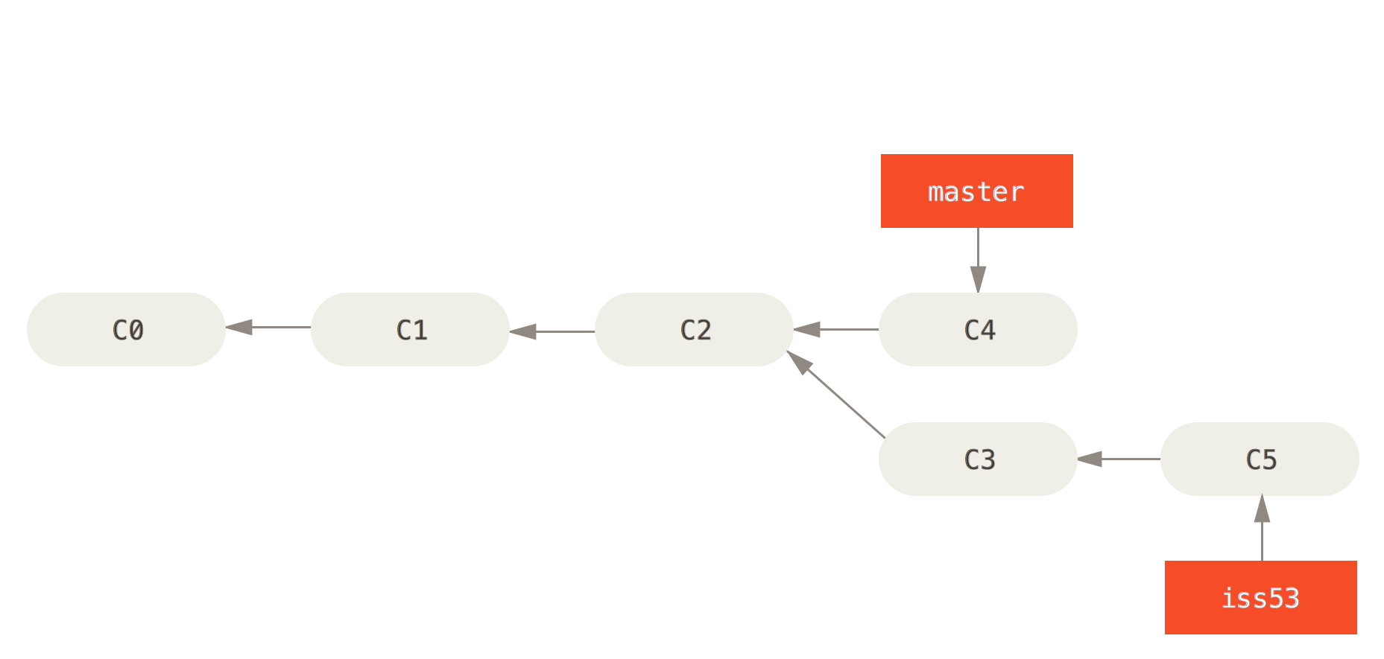
Branch
Creates a new pointer that will advance independently of the branch you had checked out when calling the command.

Slide 3
Workflow
Fetch or pull changes from your remote
If adding a new feature, create a branch to support that feature and develop there
Ready to merge that new feature back into your primary branch?
Create a new branch from the primary
Merge in the feature branch
If it worked, check out your primary branch and merge in the feature. Now you can delete that temporary branch
If it failed, figure out what you need to fix, do so, then delete the temporary branch and try again

Slide 4
Multiple Remote Branches
Keep several branches on your remote for different purposes
A branch like Master should be your latest stable version
Keep another branch around like ‘dev’ or ‘experimental’ to move changes into and test
When those are complete and the development branch seems to be working, merge that into master and continue your work on the development branch
This helps minimize the risk of breaking your latest stable release

Slide 5
Merge
Brings the contents of the named branch into the branch you currently have checked out.
Merge commits have two parents rather than one for a normal commit
Ideally able to choose a common ancestor node, then combine by checking snapshots of each
Merge conflicts possible
Conflicts only happen on your local repository, you have to fix before you can push

Slide 6
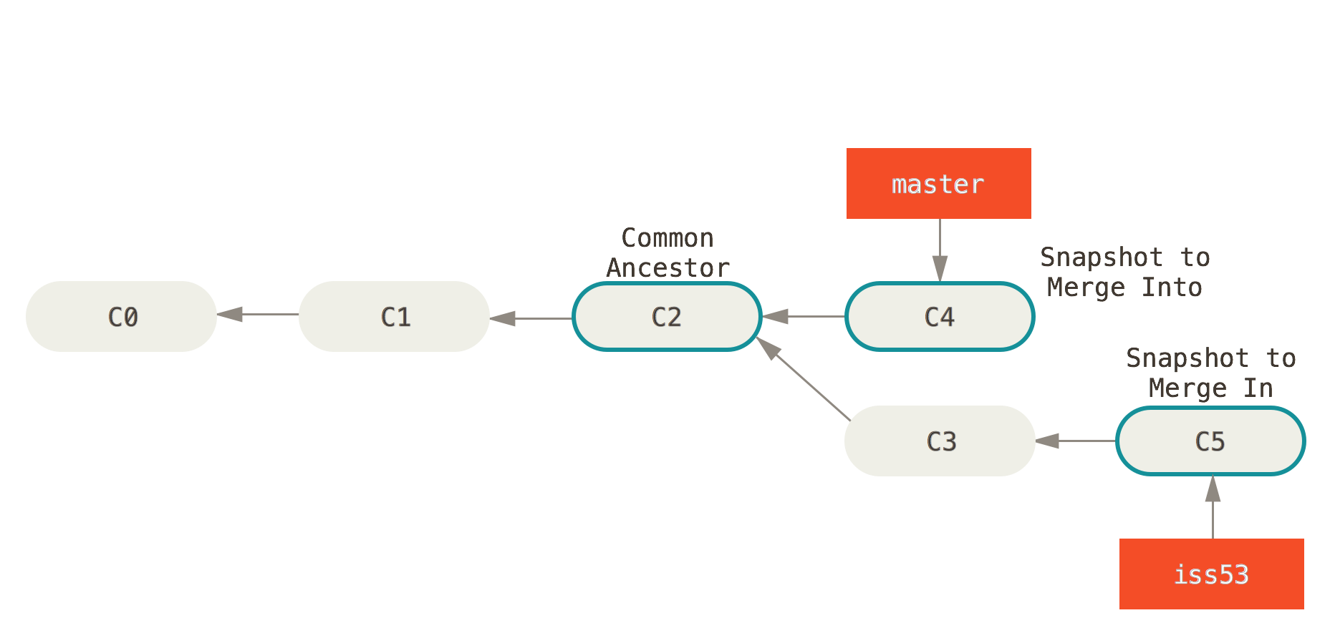
Merge cont.

Slide 7
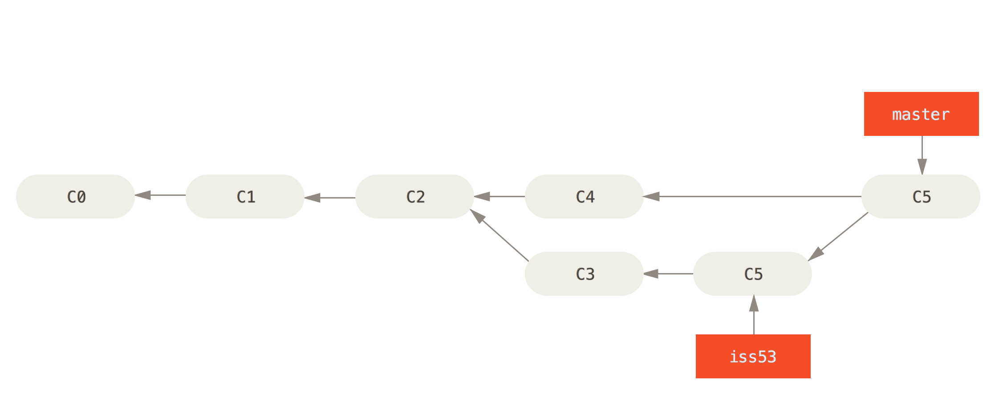
Merge Cont.

Slide 8
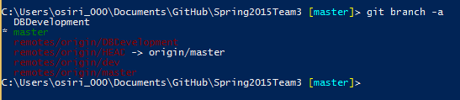
Fetch or Pull?
When using Github for Windows, hitting Sync performs a pull followed by a push
May not be ideal – conflicts possible
Fetch from command line will stage remote changes on your local repository so you can merge them in manually
Green branch is checked out
Note that there is remote/master and master

Slide 9
Undoing Ruin
Messed up and haven’t made a commit? “git checkout -- .” deletes all changes made since last commit
Messed up and you made a commit? “git reset --[hard/soft/mixed/merge] <commit hash>
Hard modifies the work tree – data is lost
Mixed is default – head pointer is moved, but working tree is preserved
Soft moves the pointer to the commit specified, but all changes still exist as staged. You can commit again immediately (re-writing history)
Merge rolls back the changes of a bad merge
All changes move the head pointer back to the specified hash
Revert will record a series of new commits that reverse previous commits
This means changes are preserved and recorded. Safer than reset, but leaves messier commit history

Slide 10
References
Discussion on reverting and resetting changes
http://stackoverflow.com/questions/2530060/can-you-explain-what-git-reset-does-in-plain-english
Helpful resource discussing a branching workflow
http://www.git-scm.com/book/en/v2/Git-Branching-Basic-Branching-and-Merging
Also the source for all the images in this presentation
Discussion on fetching versus pulling changes
http://longair.net/blog/2009/04/16/git-fetch-and-merge/
Documentation for revert – just in case
https://www.kernel.org/pub/software/scm/git/docs/git-revert.html
Documentation for reset – just in case
https://www.kernel.org/pub/software/scm/git/docs/git-reset.html
Organizing Workflow
http://nvie.com/posts/a-successful-git-branching-model/

